Slide 1

NSRIC Inc. (Nature Science Research and Innovation Centre)
Ontario (ON), Canada
Online Education (OE) Division
Consumer Behavior
Instructor: Kathy Chen
Marketing Program, OE Division
NSRIC Inc.
London, ON, Canada
E-mail: kathyjchen18@gmail.com
https://www.nsric.ca

Slide 2
Week 10: Advertising & Response
Content covered in this week:
5.5 Aristotle's communication model
5.6 Elaboration likelihood model
5.7 Effective advertising
5.8 Advertising effectiveness

Slide 3
Week 10: Advertising & Response
5.5 Aristotle’s Communication Model
In order for retailers and marketers to entice consumers towards their product, they must be able to practice effective persuasive communication. Aristotle’s Communication Model, an early model of marketing communication, describes the three elements necessary for this to occur. In this section, we explore these three elements and relates them back to persuasive branding, while also explaining some research that has shown opposite effects of the model.

Slide 4
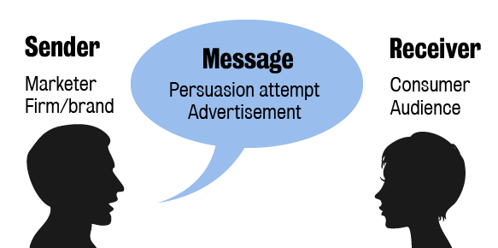
Week 10: Advertising & Response
5.5 Aristotle’s Communication Model
Communicating a message
All communication involves two parties, two people or two groups of people (a sender and a receiver) and a message. The sender is the marketer or agent/firm who encodes the message (also called persuasion attempt or advertisement) in words, visuals, music, gestures, etc. The receiver is the consumer and audience of the message and they decode the message through
hearing, sight, etc.
by processing the
message in their brain
using both system 1
and 2 to understand
the meaning.

Slide 5
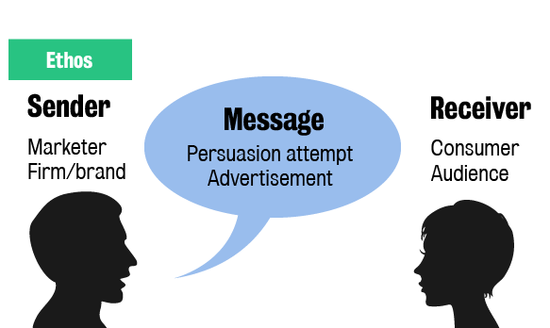
Week 10: Advertising & Response
5.5 Aristotle’s Communication Model
Aristotle’s Communication Model in detail
Aristotle’s Communication Model, also known as the transactional communication model, describes the three elements necessary for persuasive communication: ethos, pathos and logos.
Ethos
The sender needs to have credibility.

Slide 6
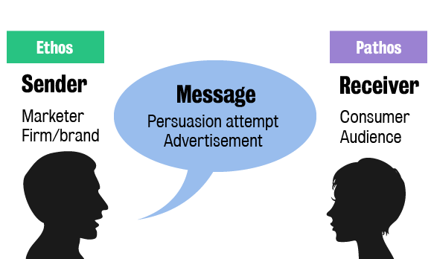
Week 10: Advertising & Response
5.5 Aristotle’s Communication Model
Pathos
The receiver needs to have ‘passion’; the receiver needs to feel positive about the message.

Slide 7
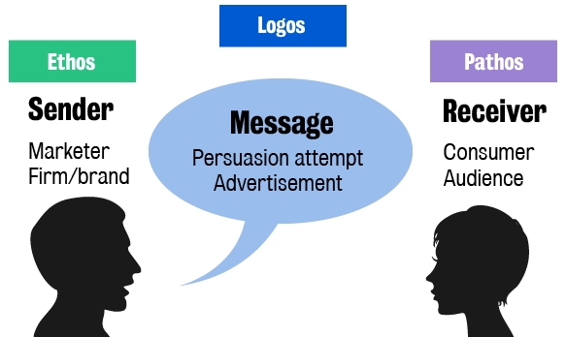
Week 10: Advertising & Response
5.5 Aristotle’s Communication Model
Logos
The message needs to be logical or rational to increase the chances of persuasion.

Slide 8
Week 10: Advertising & Response
5.5 Aristotle’s Communication Model
Research into the model
Early advertising research into this model showed that high ethos or credibility of the sender, more logos or credible arguments, and positive pathos or emotion, all contributed to the persuasion of the message leading to elaboration. If you remember, elaboration is the highest form of involvement where the consumer can change their attitudes, and attitudes are our thoughts, feelings or intentions, and their actual behavior.

Slide 9
Week 10: Advertising & Response
5.5 Aristotle’s Communication Model
Research into the model
However, in the late ‘70s and early ‘80s, some advertising researchers and psychologists started finding different effects of this model. For example, more ethos only mattered if the sender was consistent with the product or service advertised and more logos only mattered to the extent that the cognitive decision model was activated (how consumers make decisions and it doesn’t apply to impulse purchases). Therefore, the researchers concluded that the model did not apply to impulse purchases. In addition, negative pathos had similar persuasion effects to positive pathos for some products, such as insurance where playing on customer anxieties can help persuade consumers to buy your service.

Slide 10
Week 10: Advertising & Response
5.6 Elaboration Likelihood Model
In this section, we come back to the idea of parallel processing by looking at the Elaboration Likelihood Model. This model explains how each stimulus in an advertisement or message – whether it be a noise, a smell or the content itself – can be processed using either the central route or the peripheral route. What is the difference between these two routes in processing ability and motivation? How does the mind decide which route to process a stimulus?
Once we answer these questions, you will get a chance to analyze two advertisements and see how your own mind processes stimuli.

Slide 11
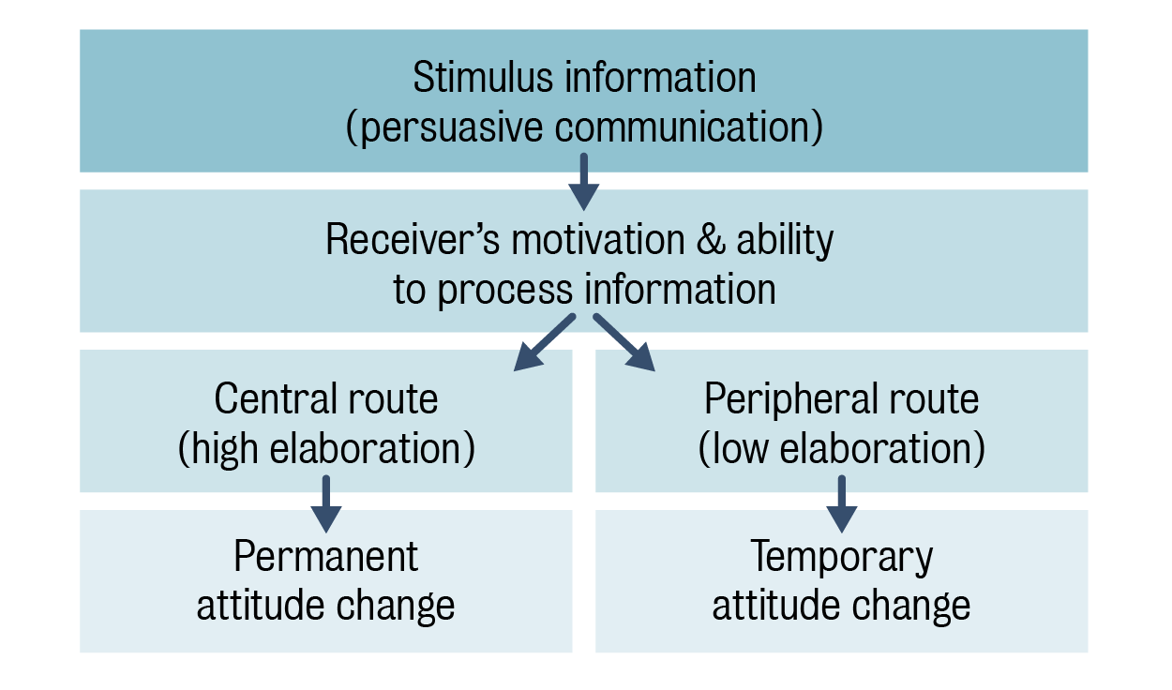
Week 10: Advertising & Response
5.6 Elaboration Likelihood Model
The model
To solve the issues with Aristotle's classical view of communication, the Elaboration Likelihood Model (ELM) was developed by Petty & Cacioppo (1986) to better explain how persuasion works by introducing the two paths of persuasion.
To solve the issues with Aristotle's classical view of communication, the Elaboration Likelihood
Model (ELM) was
developed by Petty &
Cacioppo (1986) to better
explain how persuasion
works by introducing the
two paths of persuasion.

Slide 12
Week 10: Advertising & Response
5.6 Elaboration Likelihood Model
Persuasive communication – including advertisements, speeches, sales pitches – attempts to convince the audience of the validity of the message through many stimuli. In other words, the sender wants to convince consumers or the wider audience to change their attitudes towards the topic of the message. Each stimulus or aspect of the message, including content, tone, music, smell, gestures, etc., is processed using one of two routes: the central route or the peripheral route.

Slide 13
Week 10: Advertising & Response
5.6 Elaboration Likelihood Model
Think back to parallel processing. Each part of the persuasion attempt can be processed in parallel, but not all parts or stimuli are processed the same way. The central route (or high elaboration) is how Aristotle saw persuasion. He thought that by stating logical arguments, people with credibility could convince or persuade other people to change their mind or attitudes. This central route is a system 2 or cognitive mind process. The main contribution of the ELM is that some stimuli will be processed through the peripheral route, probably using system 1. As we know, system 1 can influence decisions and even build links and association between nodes or concepts. For this reason, the power of the peripheral route is not to be underestimated. In fact, if you look at classical advertising from the 1950s, the content was about establishing credibility and presenting logical arguments. More modern advertising does not present as many blatantly logical arguments and, instead, tries to stimulate both routes.

Slide 14
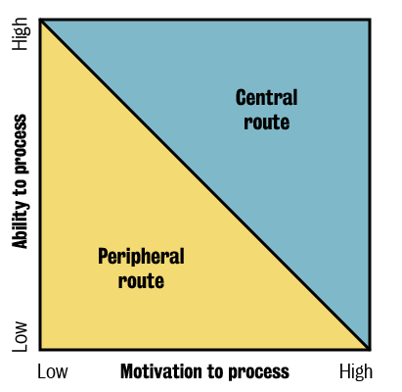
Week 10: Advertising & Response
5.6 Elaboration Likelihood Model
So, how does the mind decide which route to process information from a stimulus? The receiver’s motivation to process and their ability to process decide which route. If the stimulus is interesting, important, risky or personally relevant to the receiver, the motivation to process will be high. However, our minds have limited capacity to process information using system 2, and if we are exhausted, a receiver cannot process even the most interesting information.
A simple graph shows which processing
route is more likely: with high motivation
and high ability to process, it will likely be
the central route, while with low motivation
and low ability to process, it will be the
peripheral route.

Slide 15
Week 10: Advertising & Response
5.6 Elaboration Likelihood Model
Last, both processing routes can have impacts on attitudes, but they differ in how long that impact lasts. The central route can result in permanent attitude change and the peripheral route can have temporary attitude effects. Marketers, of course, want to change attitudes permanently, so what is the benefit of a temporary attitude change? If you can temporarily convince someone of the benefits of a product, then they are likely going to try it. With trialing, comes personal experience, which adds lots more information and creates nodes and links that might result in a permanent favorable change in attitude.

Slide 16


Week 10: Advertising & Response
5.6 Elaboration Likelihood Model
Watch the two videos below and write down your thoughts on the questions for each of the advertisements. We will be discussing the questions in this week's webinar.
Which stimuli do you notice first? What makes them so powerful?
Watch the advertisement again. What do you notice now? Why did you not notice them before?
How were these stimuli processed? Which ones were processed through the central and peripheral routes?
Overall, which processing route was used more in this advert? Why?

Slide 17
Week 10: Advertising & Response
5.7 Effective advertising
Throughout the module, we have learned about many different aspects of marketing and advertising, so it is only fitting that we end this week’s learning by discussing what aspects of an advertisement make it effective to its audience.
We first define what the end goal of an advertisement should be. Then, we consider the factors that could affect consumer response to an advertisement. Is a shorter or longer advertising campaign more effective? We answer this by exploring the concentration effect. Finally, we look at the advertising response model to observe how exposure and processing can affect cognition and to understand the long and short-term effects of campaigns.

Slide 18
Week 10: Advertising & Response
5.7 Effective advertising
Changing behavior
Advertisements should eventually change a consumer’s behavior. For instance, an advertisement should result in recruiting new customers or donors to a product or cause. Alternatively, an advertisement should result in existing customers, for instance, buying more, paying more per unit, driving more safely, saving fuel or stopping smoking.
These behavioral effects are helped by:
better targeting and positioning
improved distribution
word-of-mouth transmission of the ad message
increased satisfaction with the product.

Slide 19
Week 10: Advertising & Response
5.7 Effective advertising
There are a number of factors that change the response to advertising:
number of exposures and concentration in a period
recency of the last exposure
effective frequency
audience characteristics (income, loyalty, deal proneness, etc)
medium choice
content creativity.

Slide 20
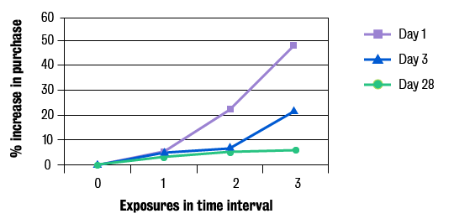
Week 10: Advertising & Response
5.7 Effective advertising
Concentration effect
The concentration effect implies that there is an acceleration of purchasing when an advertising campaign is shorter versus longer. The graph shows that the concentration effect is stronger and more effective at increasing sales for a campaign concentrated in one day compared to over three or 28 days. By concentrating messages into a shorter time frame, the persuasive changes on attitudes have little time to decay and the call for action or
purchase compounds.
This concentration
effect may be
explained as a
breakthrough or
when the ad is
noticed despite clutter
or competitor advertising.

Slide 21
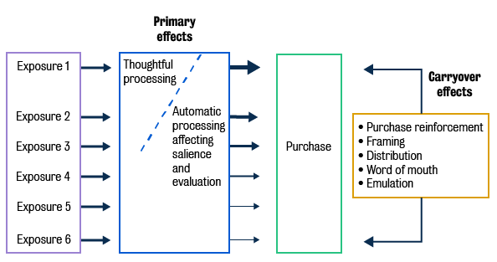
Week 10: Advertising & Response
Advertising Response model
This model is consistent with the evidence that there are short- and long-term effects of advertising campaigns. With exposure, we have different primary effects as the advertising campaign's messages are processed either through system 1 or system 2. Early exposures can produce strong cognitive effects
(system 2) and continuing
exposures can
produce weak
automatic effects
(system 1). These
lead to a purchase
or, at least, the
likelihood of a
purchase. The
carryover effects
following the purchase may relate to customer learning, market change, word of mouth influence, or copying others.

Slide 22
Week 10: Advertising & Response
5.8 Advertising effectiveness
At home practice:
Observe an advertising campaign in your city. Using what you have learned, evaluate the effectiveness of the campaign.

